Slide 1
Week 5: CAPSTONE
THE safe and secure location for opening of commercial establishments in Vancouver, Canada

Slide 2
Business Problem
FINDING A SAFE PLACE TO opening any business place like Grocery Store in Vancouver City, Canada.
Analysing crime data for opening a grocery store and short listing a neighbourhood
the 10 most common venues in each neighborhood so that the best neighborhood where grocery store is not amongst the most common venue can be selected.

Slide 3
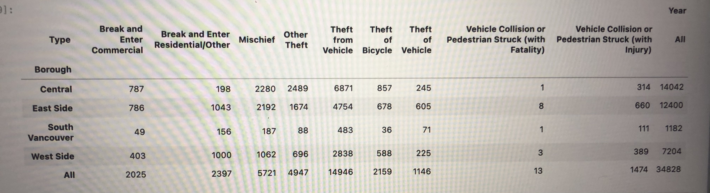
NEIGHBOURHOODS BASED ON DIFFERENT CRIME TYPES

Slide 4
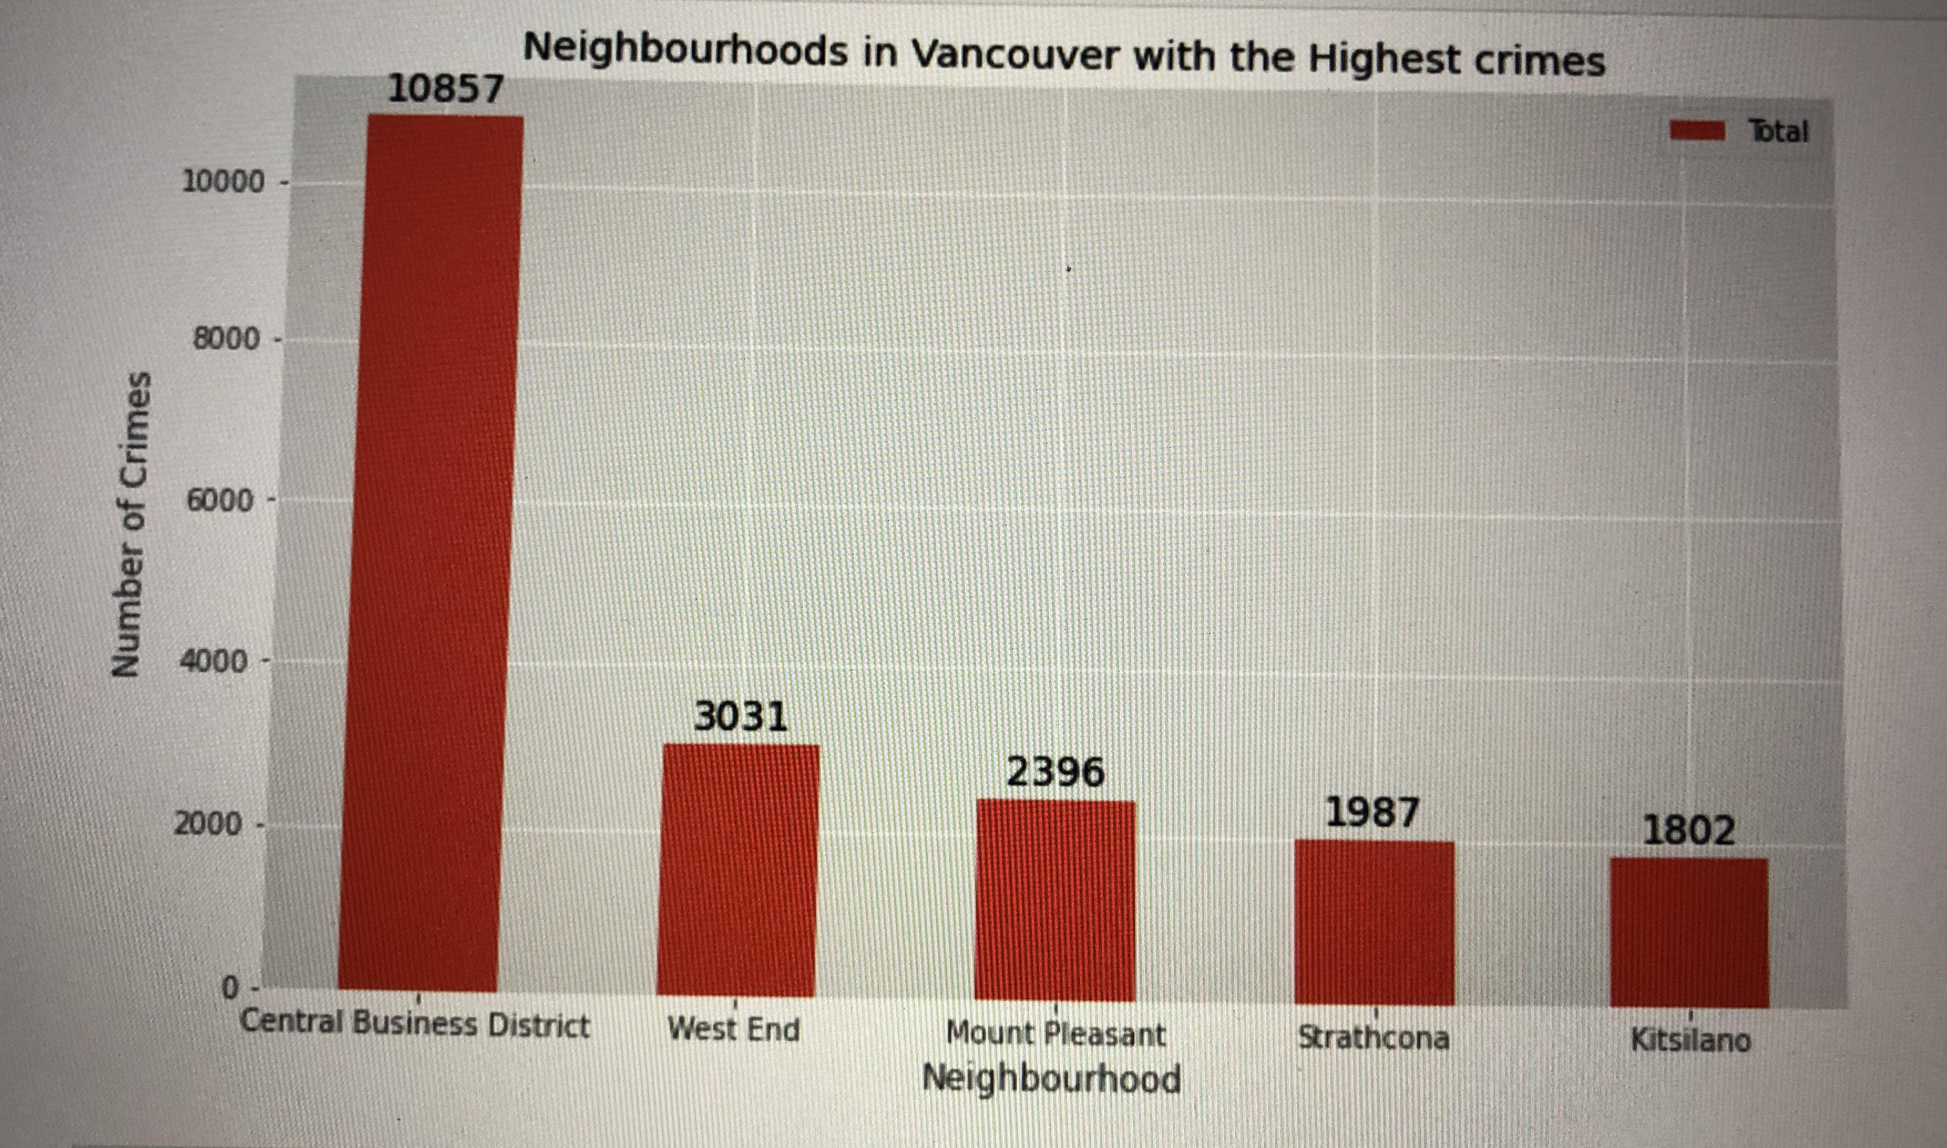
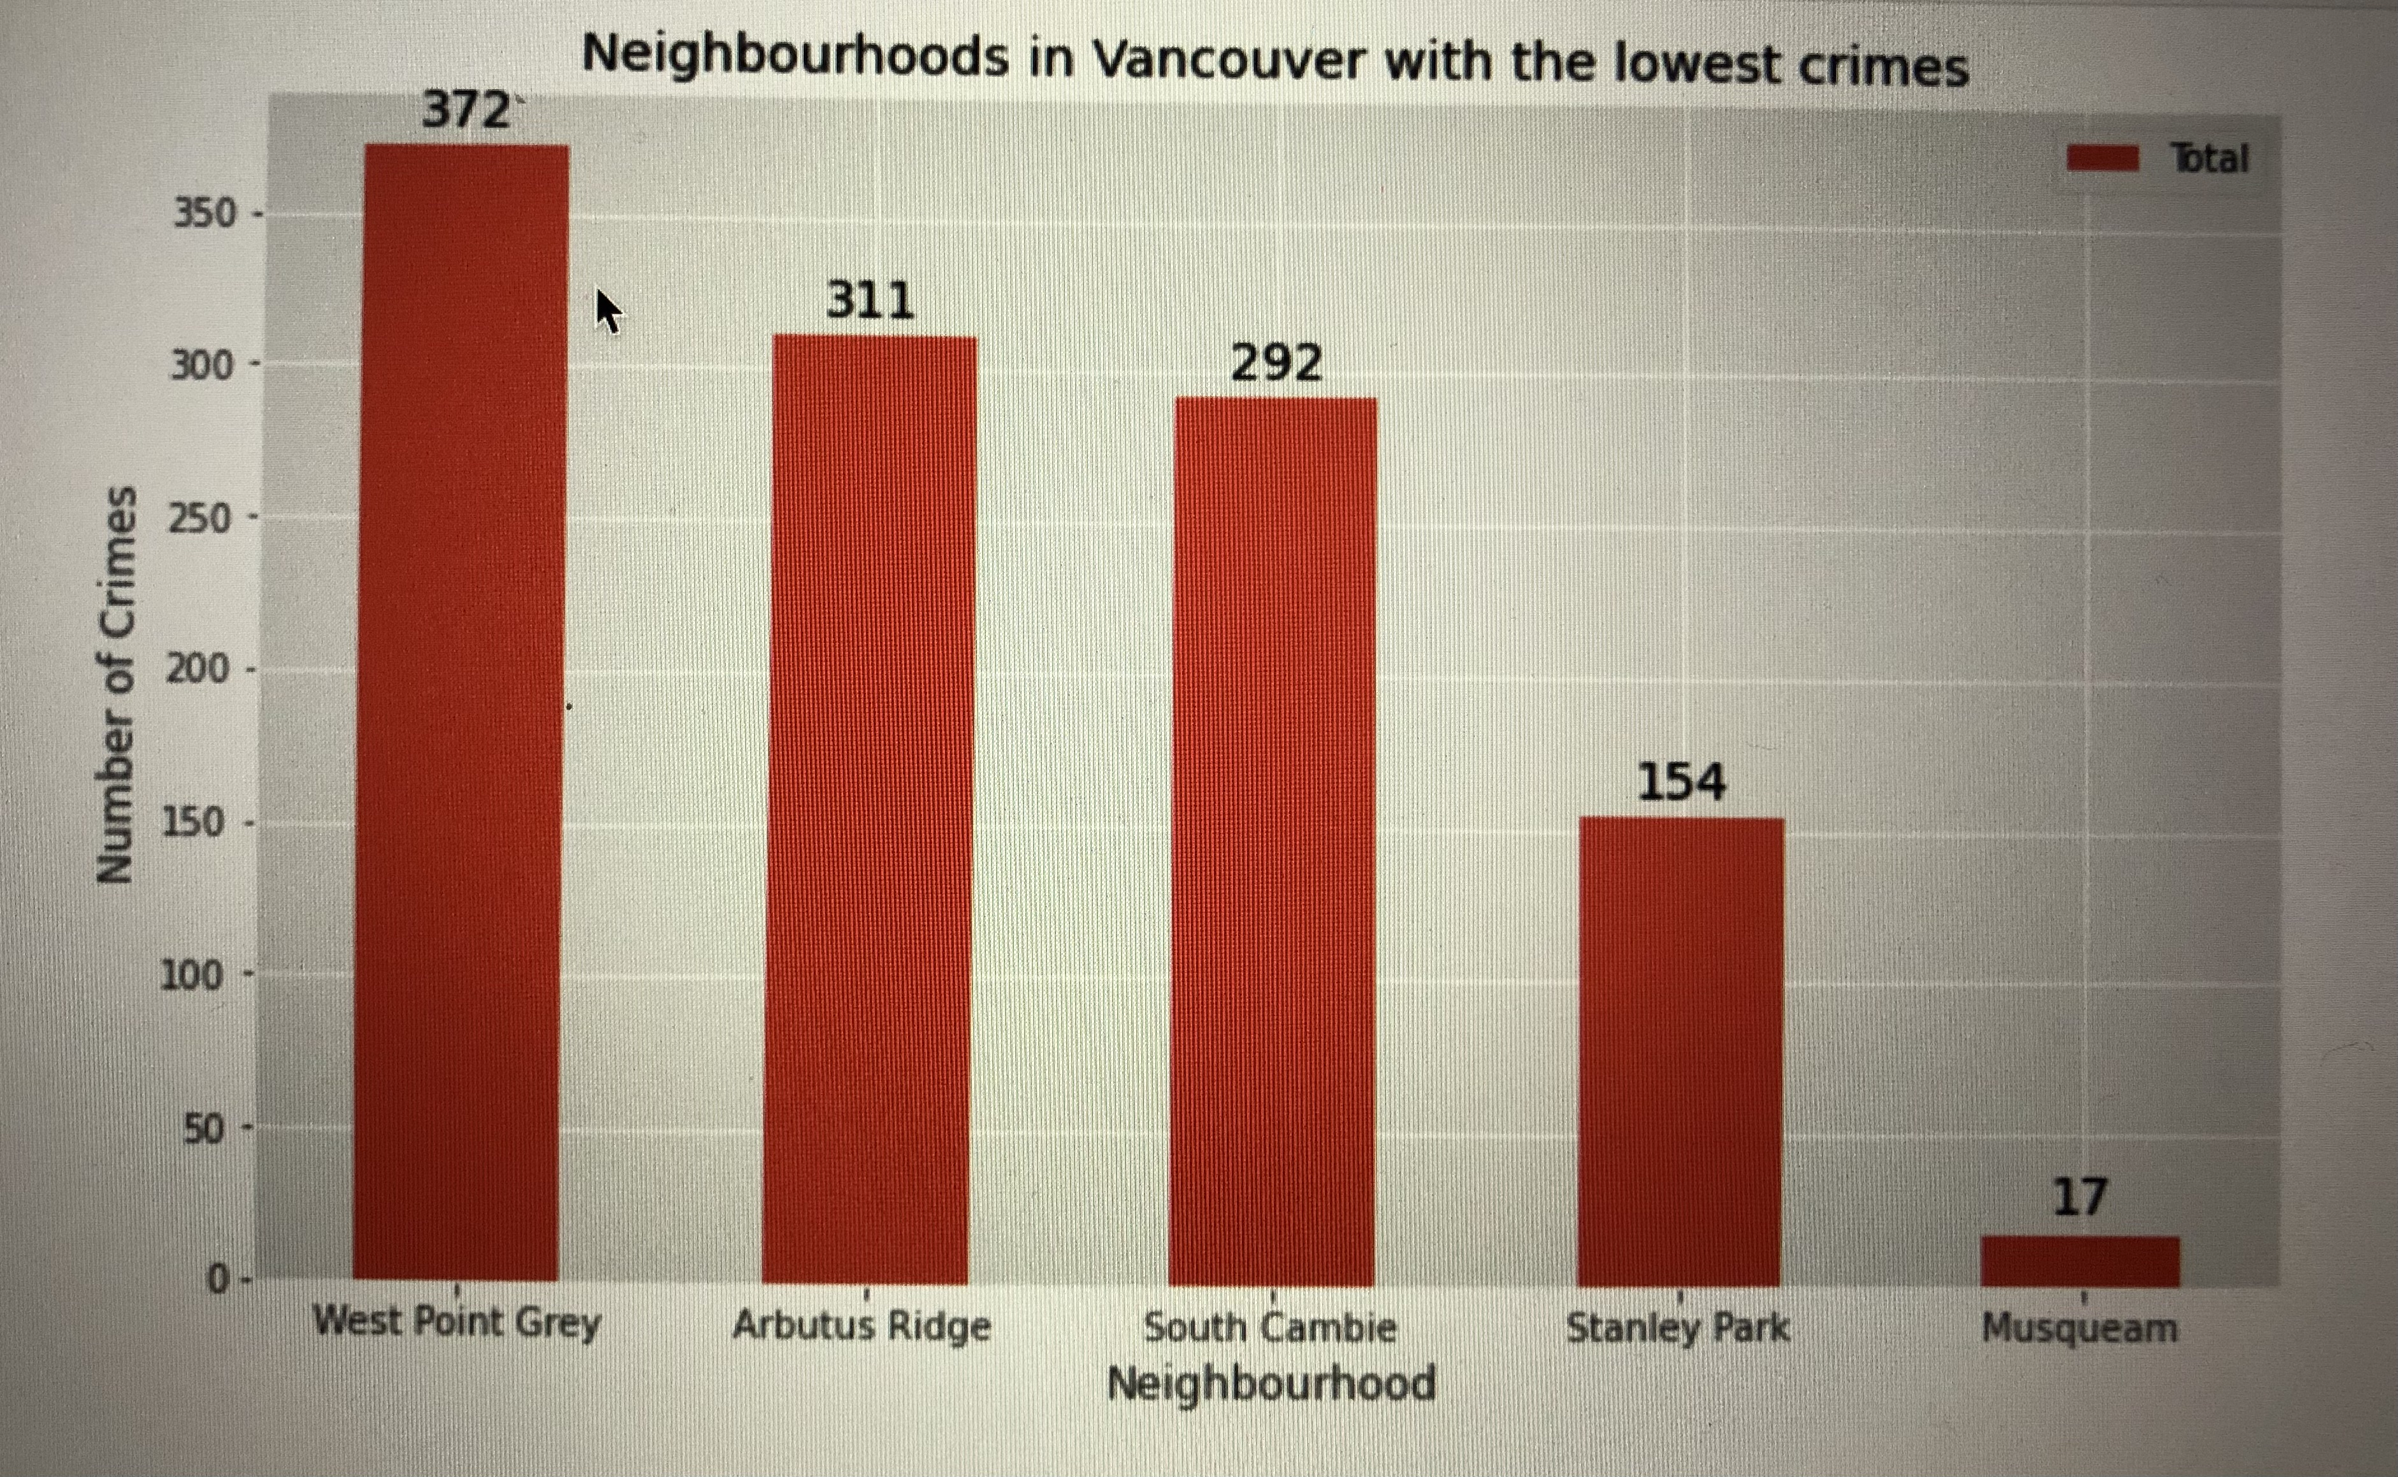
Neighbourhoods with highest and lowest crimes in Vancouver

Slide 5
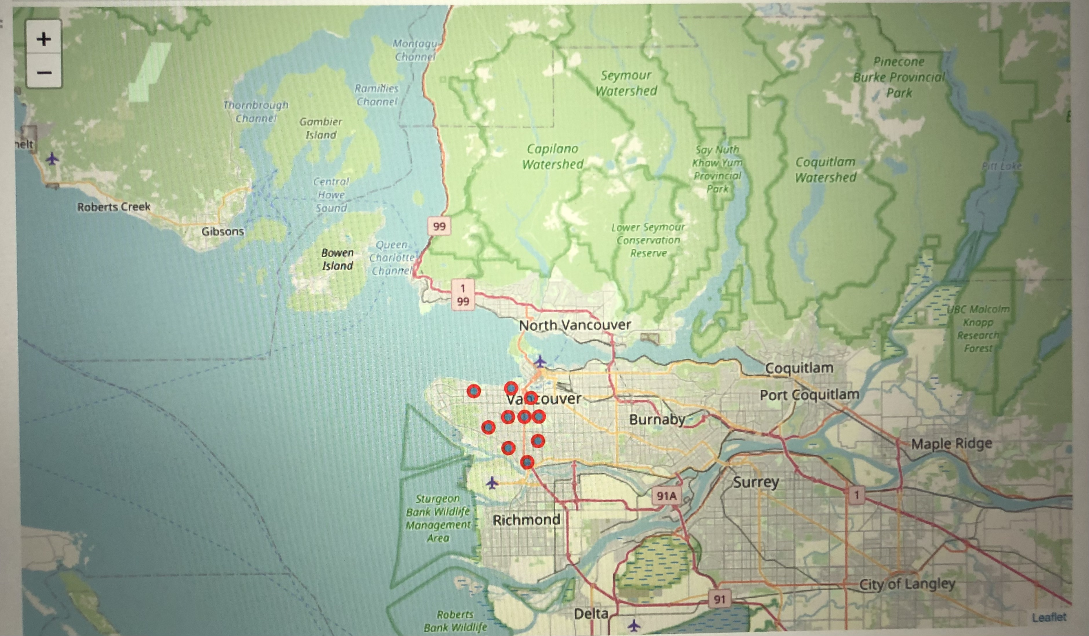
Map for crime

Slide 6
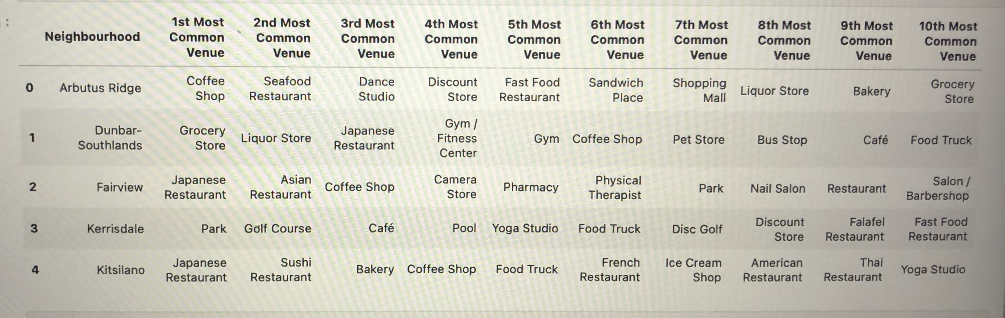
The venue distribution in the neighborhood

Slide 7
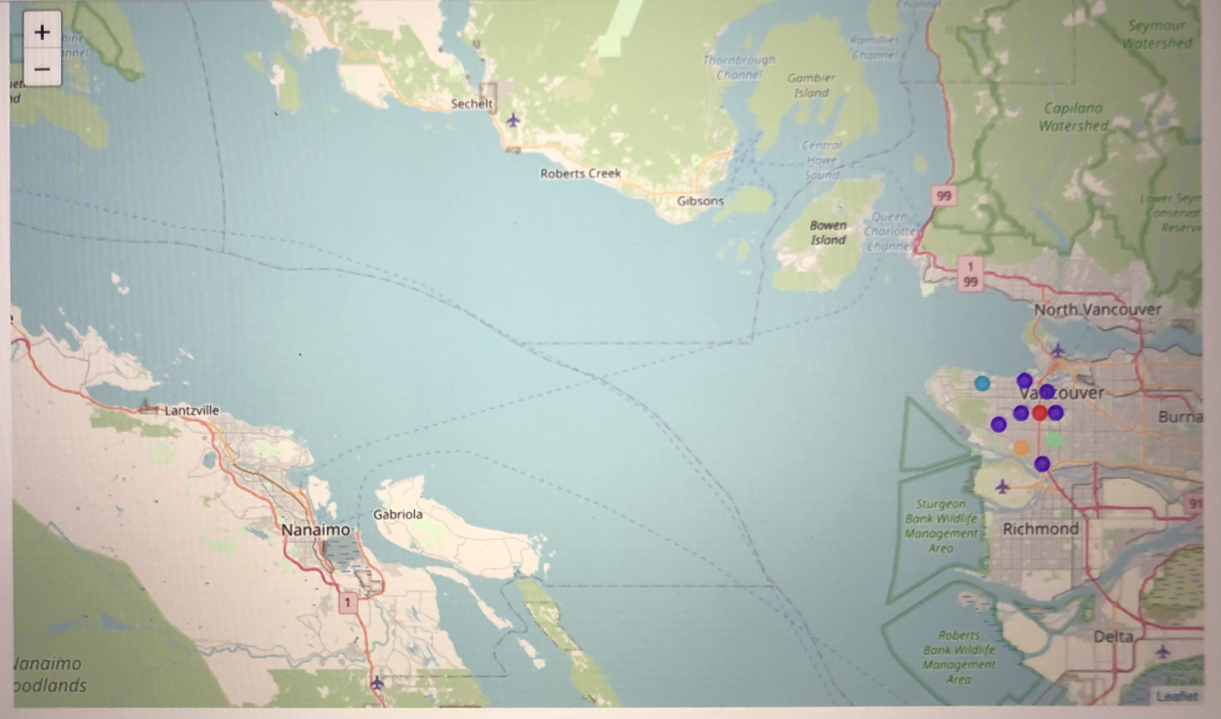
The best location

Slide 8
Results and Discussion
helping stakeholders identify one of the safest borough in Vancouver, and an appropriate neighborhood within the borough to set up a commercial establishment especially a Grocery store
making use of Vancouver crime data to identify a safe borough with considerable number of neighborhood for any business to be viable
by grouping the neighborhoods into clusters to assist the stakeholders by providing them with relavent data about venues and safety of a given neighborhood

Slide 9
Conclusion
First: exploring the crime data to understand different types of crimes in all neighborhoods of Vancouver and later categorized them into different boroughs, this helped us group the neighborhoods into boroughs and choose the safest borough.
Second: finding the neighborhoods based on the common venues, to choose a neighborhood which best suits the business problem.

